Slide 1
Geodetic Remote Sensing
Jeremy Maurer
Assistant Professor, Missouri S&T, Rolla, MO, USA

Slide 2
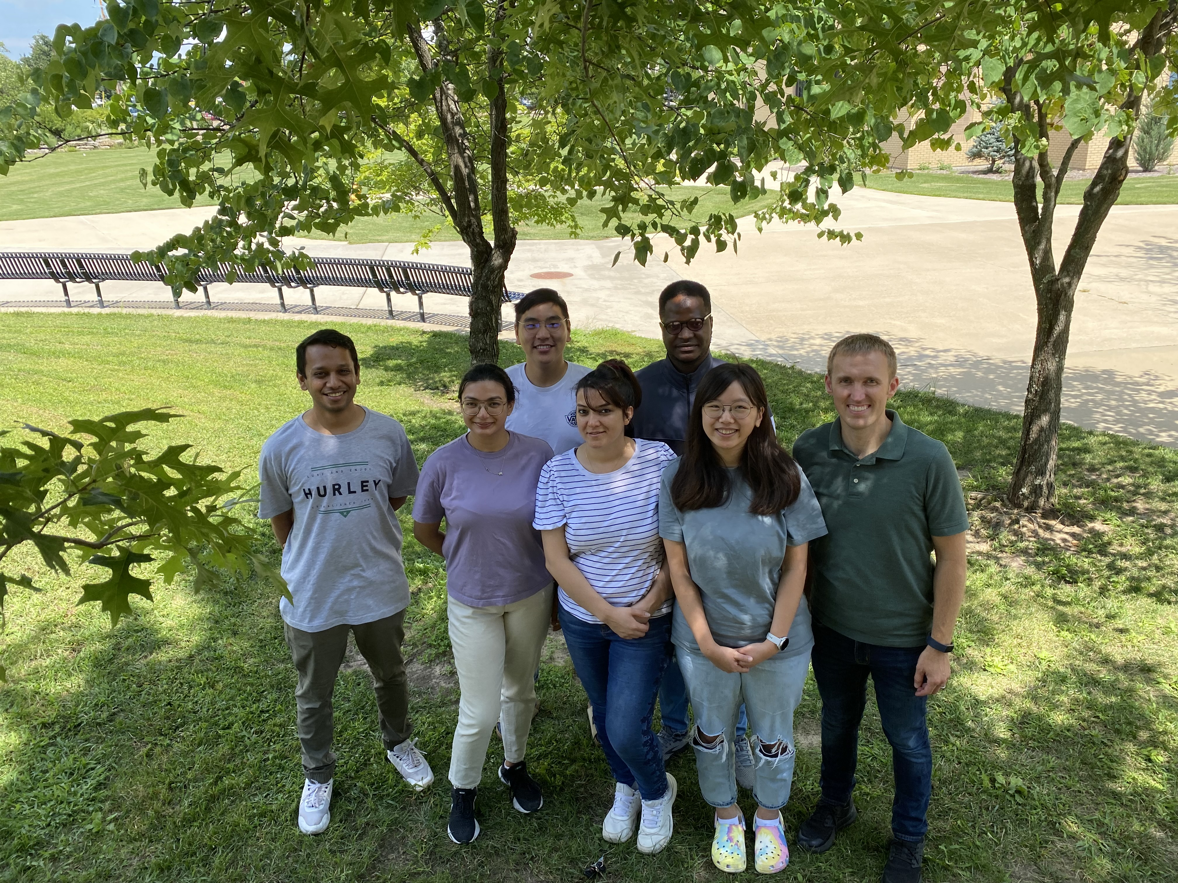
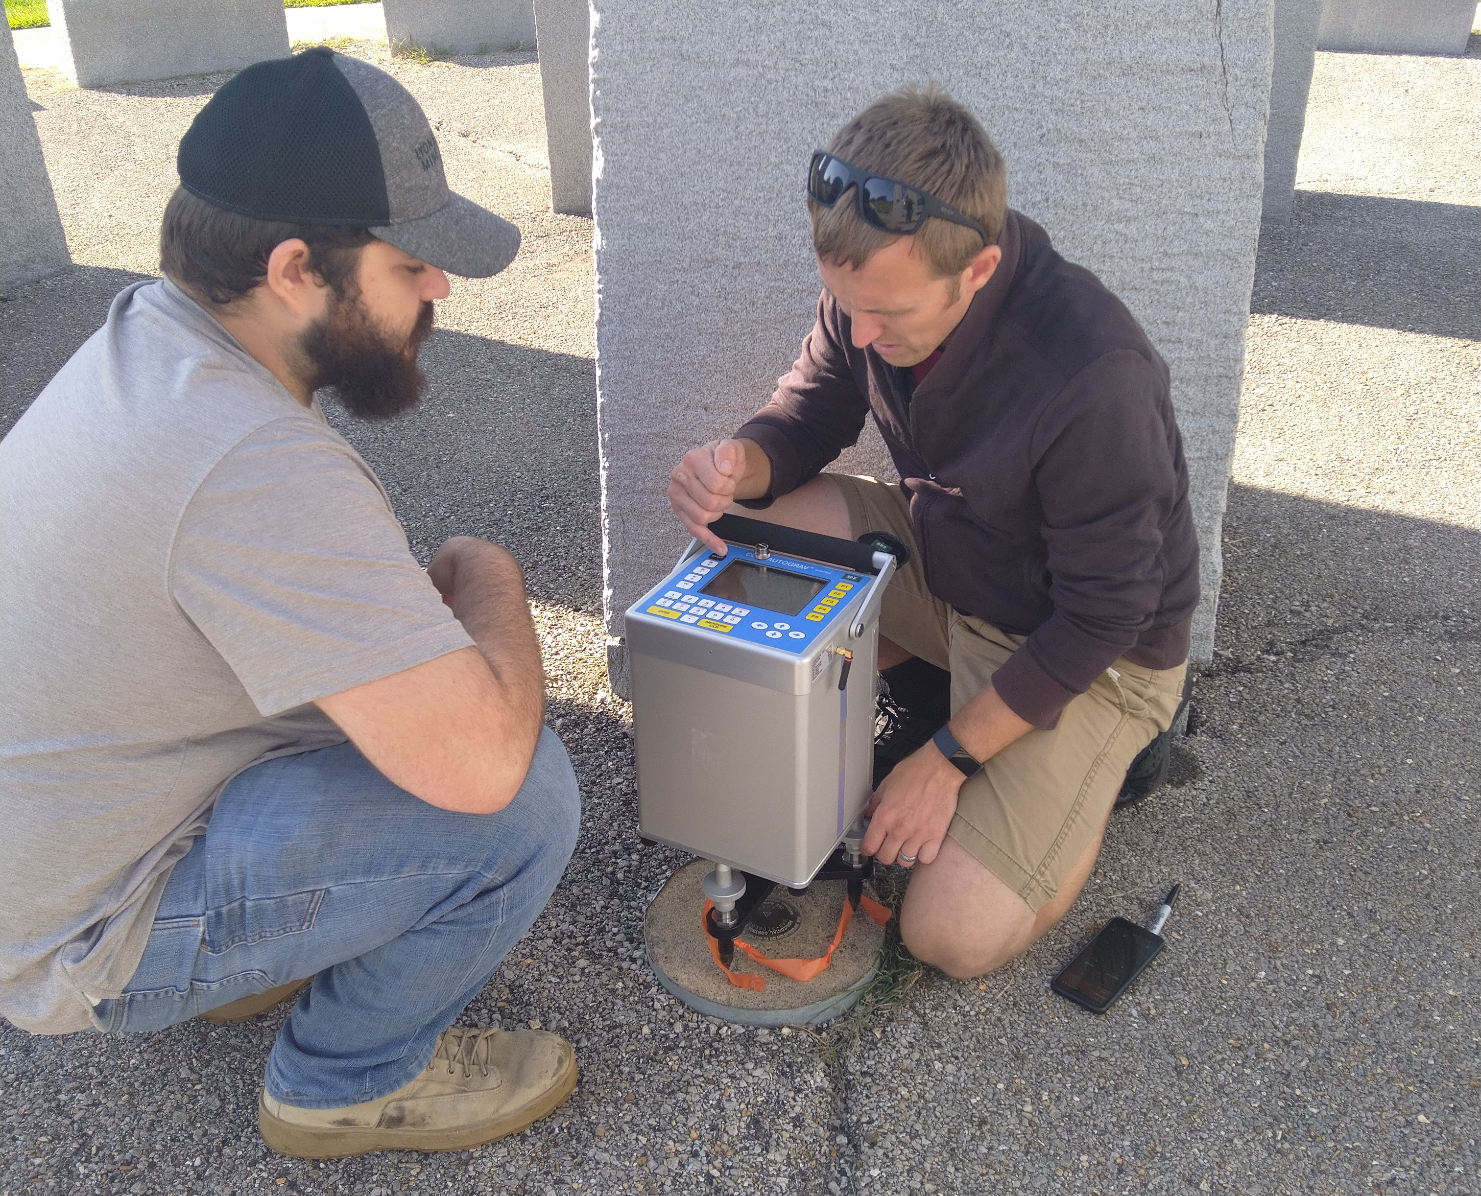
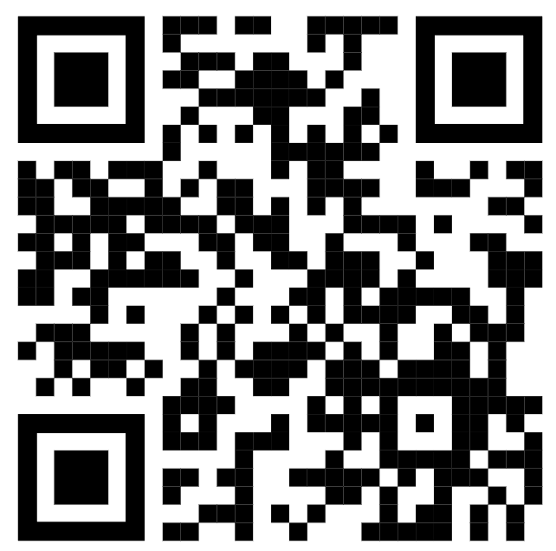
GEMLab Research Group @ Missouri S&T
GEMLab website
We do research on…
GNSS and deformation models
Tectonics and earthquake hazards
Geophysical inversion methods
InSAR processing, corrections, and analysis
Gravity
Statistical models for paleoclimate

Slide 3
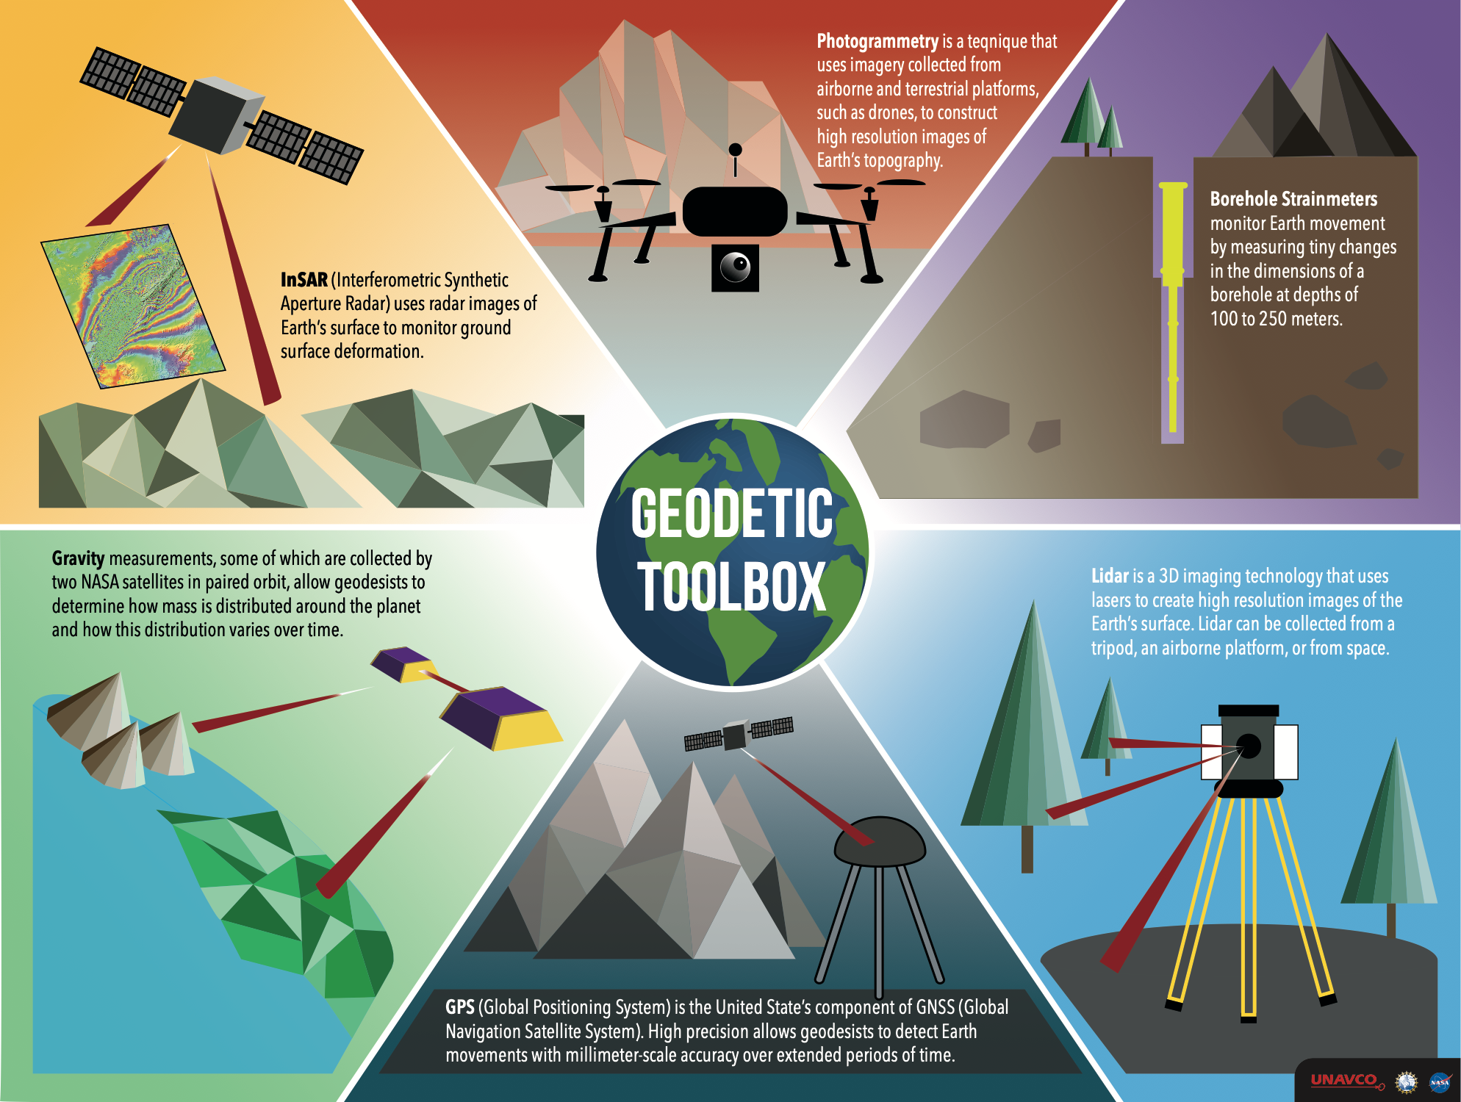
Geodesy
Geodesy is the science of accurately measuring and understanding three fundamental properties of the Earth: its geometric shape, its orientation in space, and its gravity field— as well as the changes of these properties with time.
-noaa.gov

Slide 4
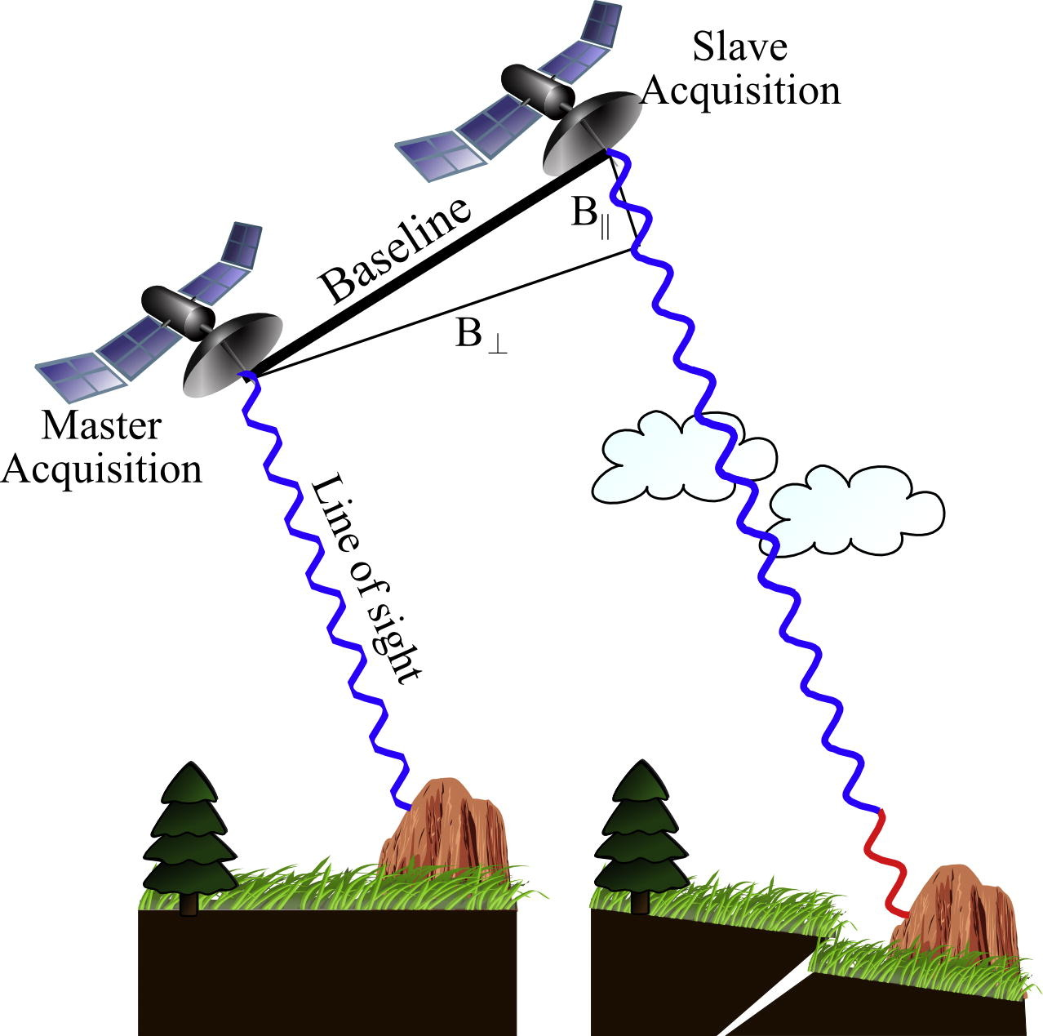
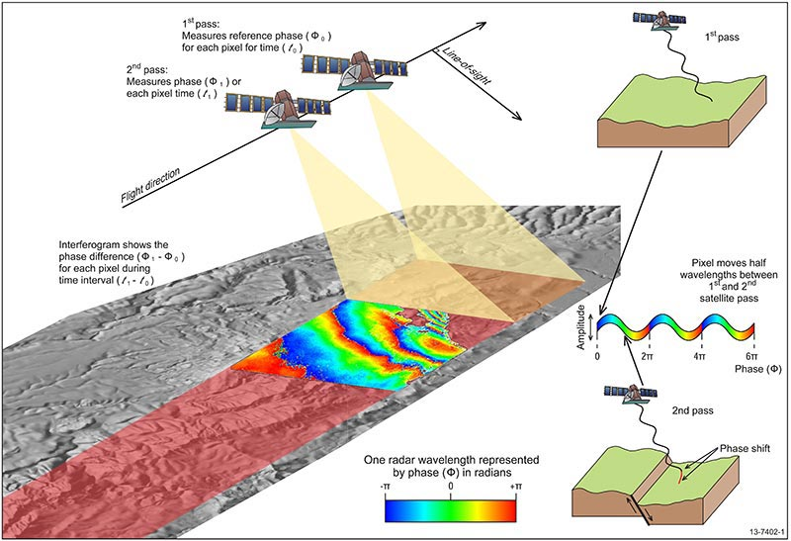
InSAR: Interferometric SAR from differencing two phase images
Osmanoğlu et al., 2016
https://www.ga.gov.au/

Slide 5
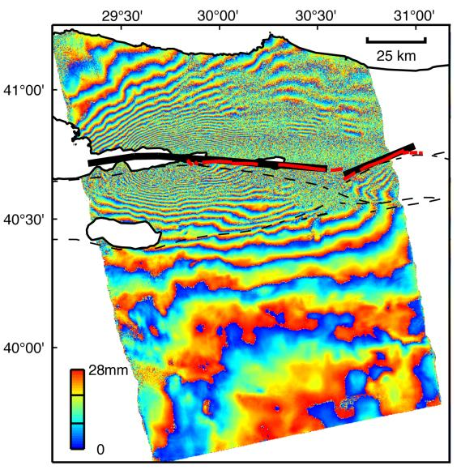
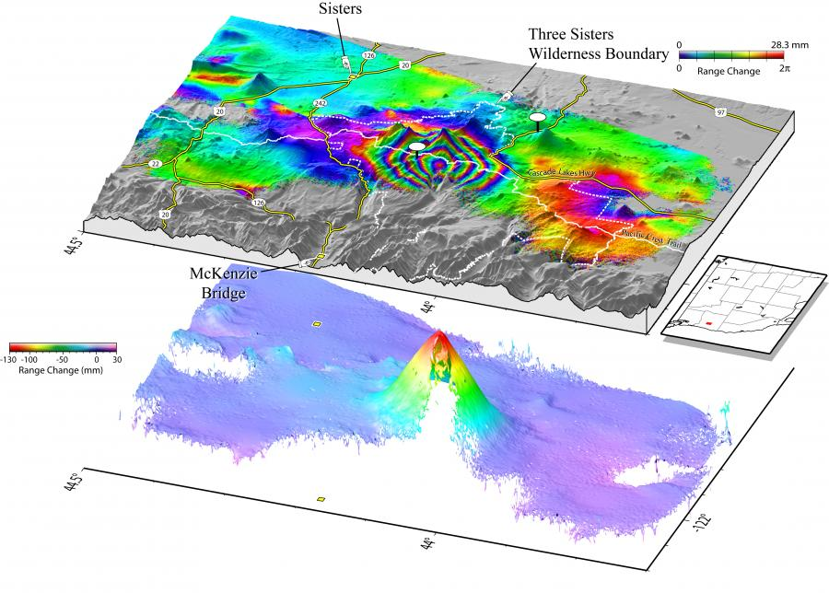
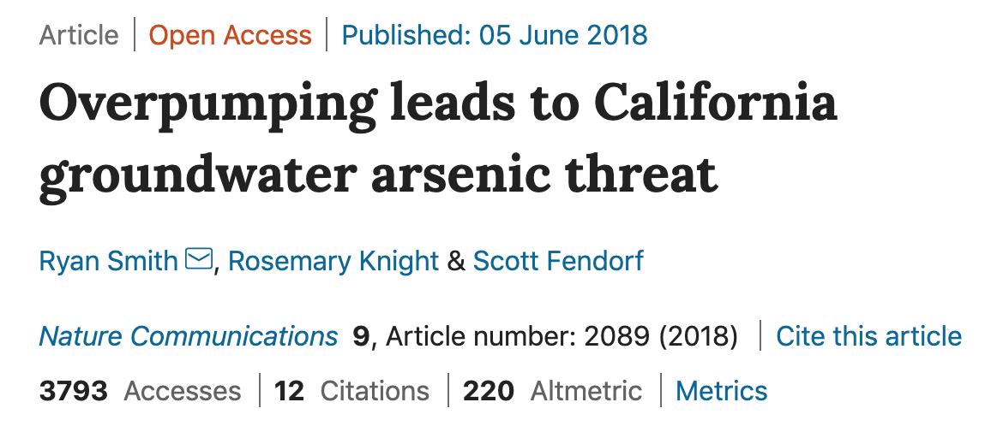
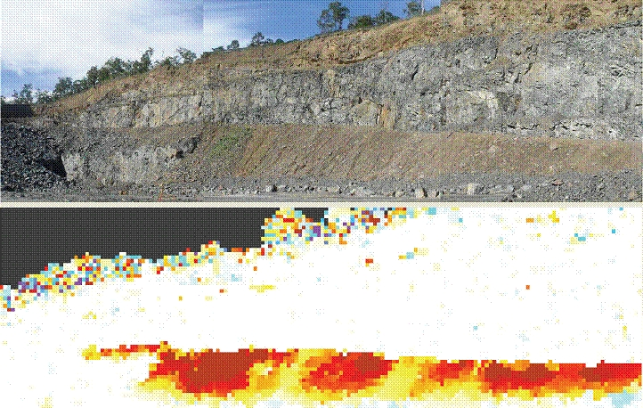
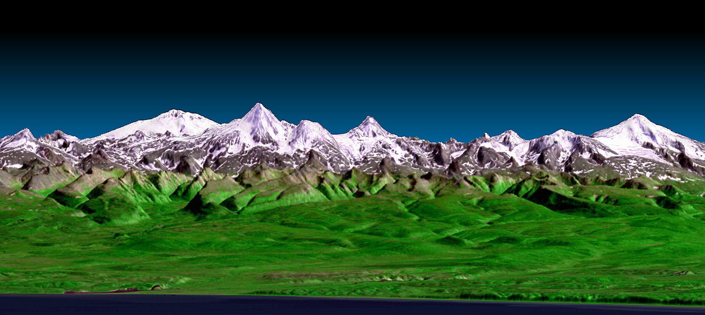
https://volcanoes.usgs.gov/vhp/insar.html
Interferogram spanning the 17 August Izmit (Turkey) earthquake. (NASA/JPL-Caltech)
Ground-based InSAR for landslide monitoring. John Catsoulis, GroundProbe Pty Ltd
Kamchatka Peninsula, Landsat data draped over SRTM digital elevation model (NASA/JPL-Caltech)

Slide 6
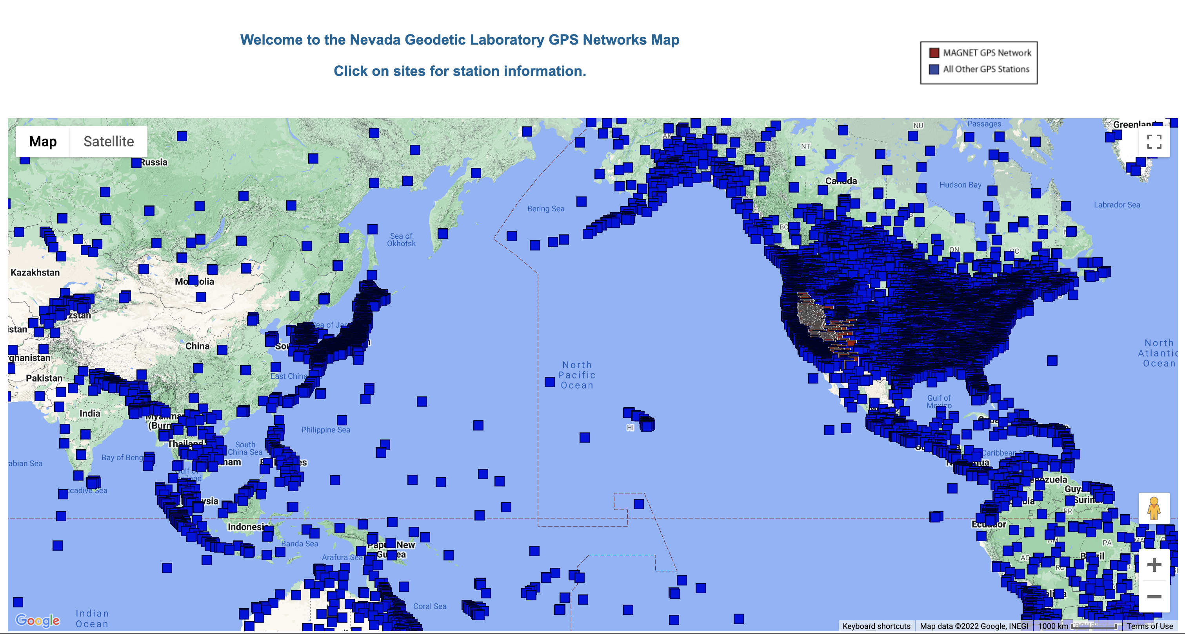
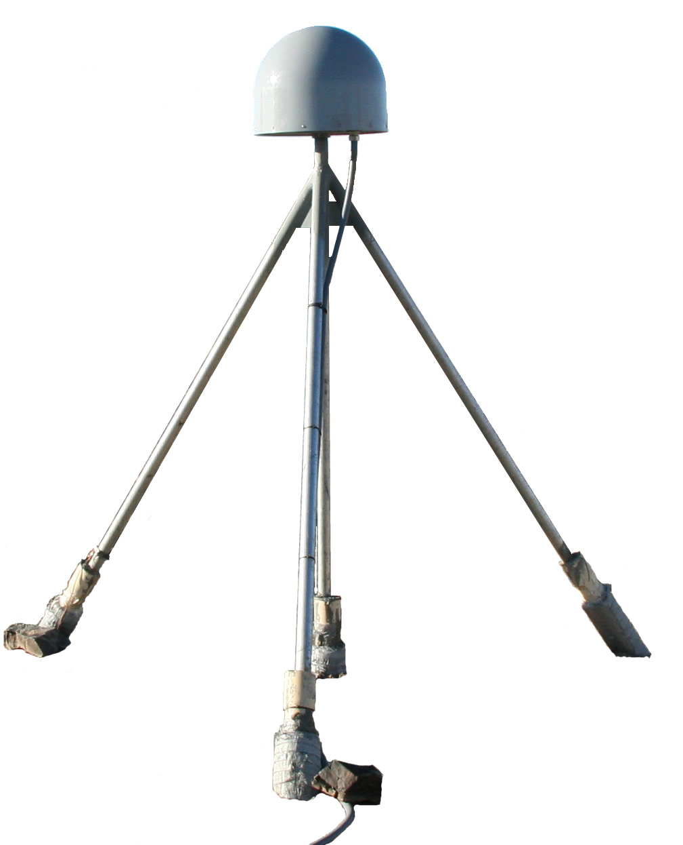
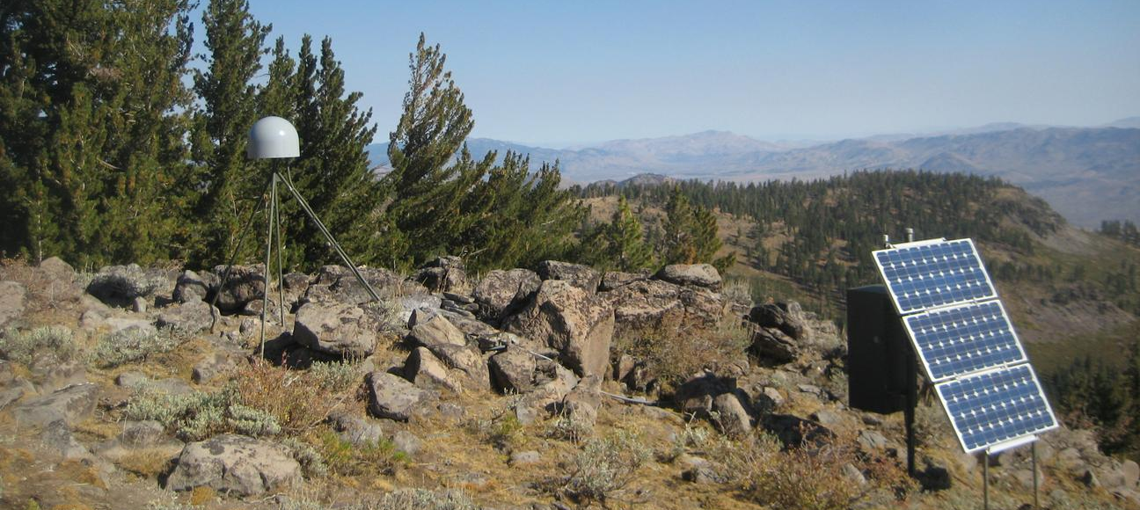
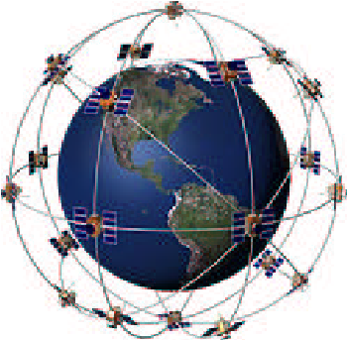
Global Navigation Satellite Systems (GNSS)
Source: Cummings et al., 2019
Source: https://serc.carleton.edu/getsi/geodesy

Slide 7
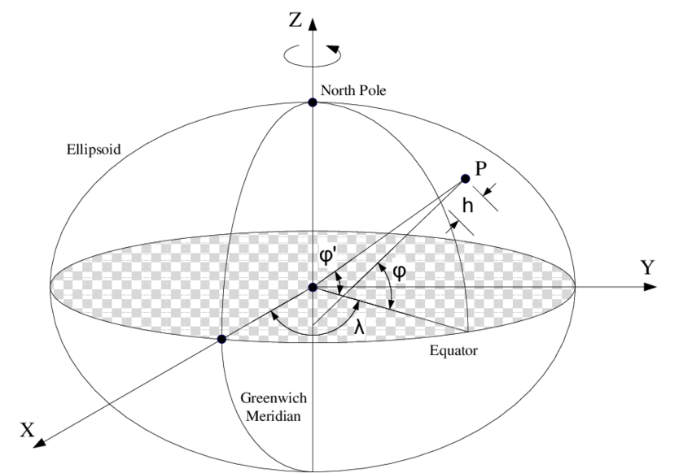
Geodetic Datums are reference frames for coordinate systems
A geodetic datum is an abstract coordinate system with a reference surface (such as sea level) that serves to provide known locations to begin surveys and create maps. In this way, datums act similar to starting points when you give someone directions. For instance, when you want to tell someone how to get to your house, you give them a starting point that they know, like a crossroads or a building address.
—https://oceanservice.noaa.gov/facts/datum.html: What is a Datum?

Slide 8
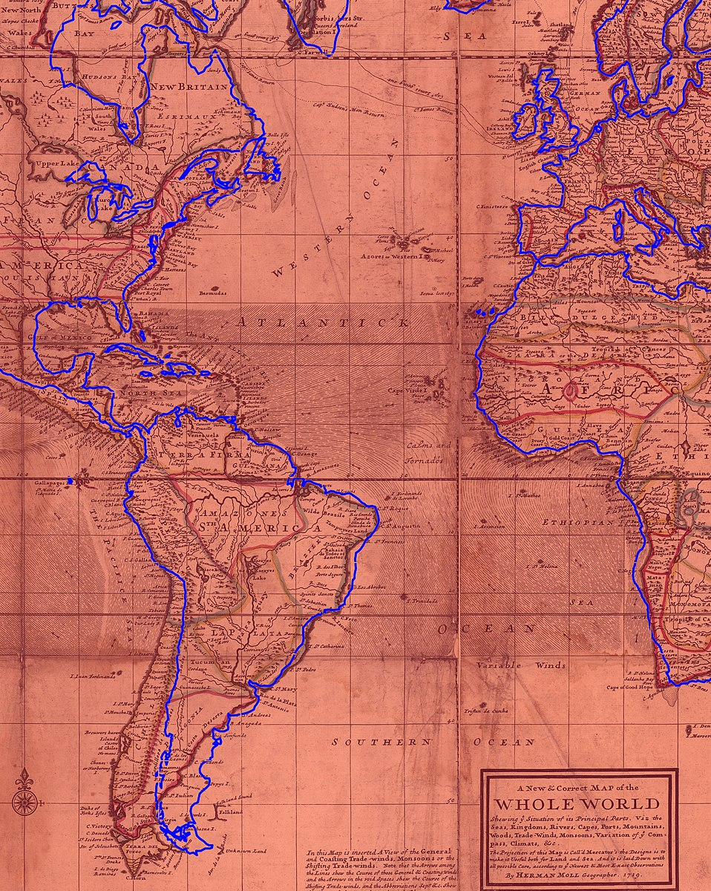
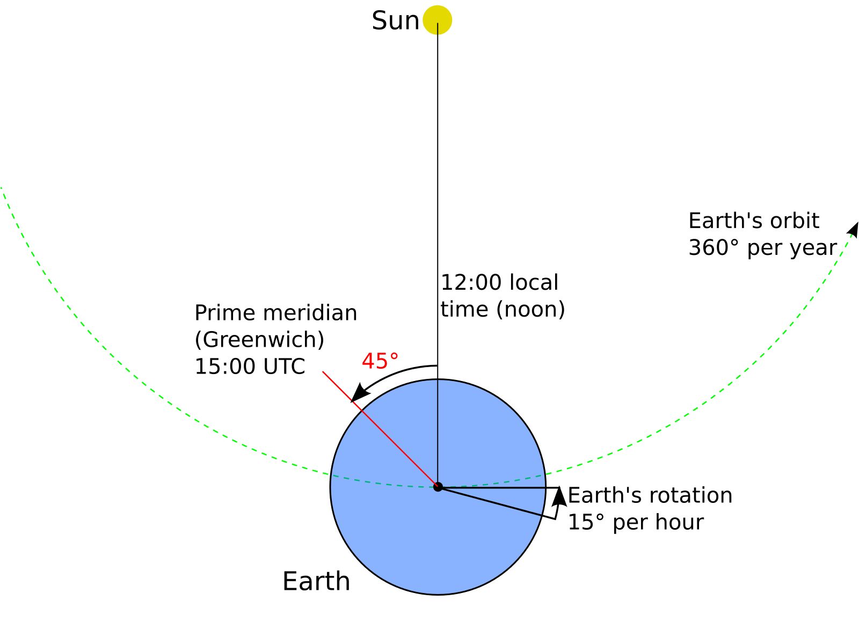
Location, Location, Location…
How do we know where we are?
Before 50 years ago, it could be quite complicated and labor-intensive to determine one’s precise location, especially in the absence of landmarks.
Modern map (blue) superimposed on with Herman Moll’s 1719 World Map
By Kognos - Own work, CC BY-SA 4.0, https://commons.wikimedia.org/w/index.php?curid=91739237
By Duff06 - Own work, CC0, https://commons.wikimedia.org/w/index.php?curid=35793011

Slide 9
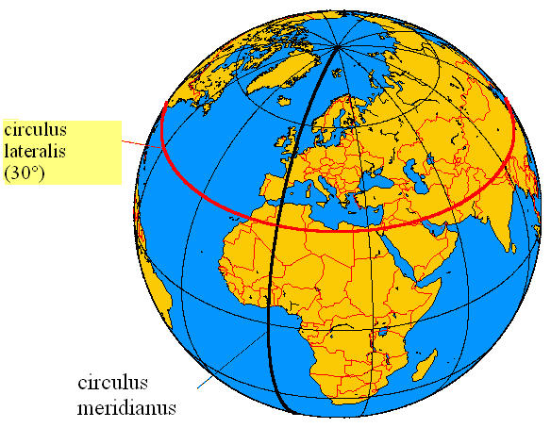

Prime Meridian in Greenwich, England
Most of the worlds navigational maps used Greenwich, England as their prime meridian, as did the US, so an international delegation voted to make it official in 1884
Laser is currently used to as a visual mark of the meridian
There are actually slightly different meridians used because of how the Greenwich meridian was originally defined, using the geoid instead of the ellipsoid
Prime meridian
By de:Benutzer:Daniel FR - German original in German wikipedia, CC BY-SA 3.0, https://commons.wikimedia.org/w/index.php?curid=1066739
Tourists at the Greenwich Observatory
By Daniel Case - Own work, CC BY-SA 3.0, https://commons.wikimedia.org/w/index.php?curid=37564411

Slide 10
Datums: a closer look
Geodetic datums are used in several contexts, including surveying, mapping, land use regulation, insurance, and so on
What information do we need to define a datum?

Slide 11
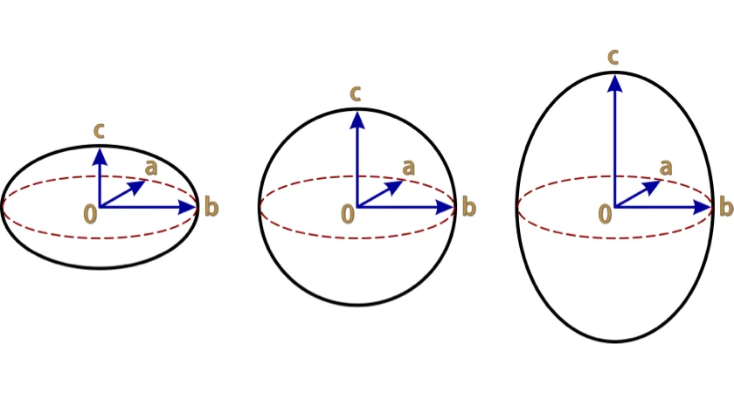
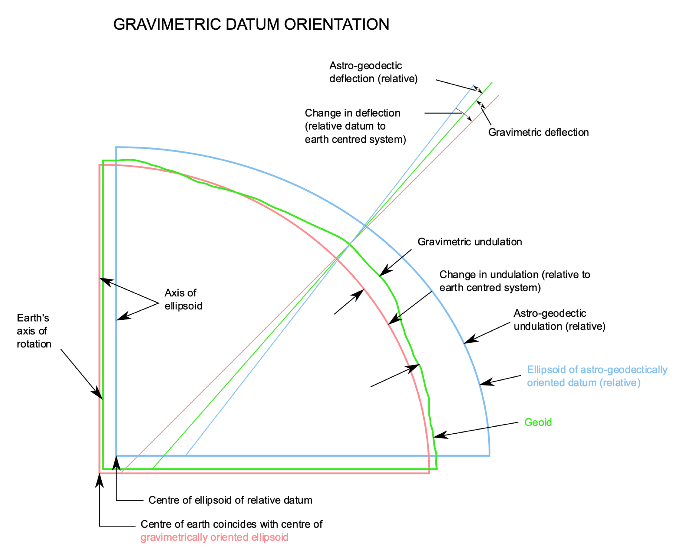
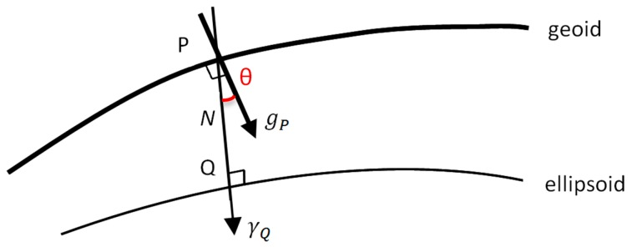
Two types of datums: Geoids and Ellipsoids

Slide 12
Type/Feature | Geoid | Ellipsoid
Shape | Represents the actual shape of the Earth's surface when all the effects of the irregular distribution of mass inside the planet are taken into account | Is an idealized model of the Earth's surface that assumes the planet is perfectly smooth and homogeneous
Measurement | Represents a physically measurable quantity | Is a mathematical construct
Determination | Determined by measuring the Earth's gravity field | Defined by mathematical equations
Deviation | Deviates from the ellipsoid by up to 100 meters in some places | Assumes a perfect sphere
Change | Changes over time as the mass distribution inside the Earth changes | Does not change over time
Application | Used in oceanography, geodesy, and satellite altimetry, plumb lines | Used in cartography and navigation, GNSS
Accuracy | More accurate than the ellipsoid when it comes to measuring the Earth's surface | Less accurate than the geoid when it comes to measuring the Earth's surface
Complexity | More complex and difficult to work with | Simpler and easier to work with
Gravity Field | Takes into account the variations in the Earth's gravity field caused by the mass distribution inside the planet | Assumes that the Earth's gravity field is perfectly uniform
Reference | Sea level | Ellipsoid surface (may not be on the Earth’s surface)
Modified from https://www.spatialpost.com/

Slide 13
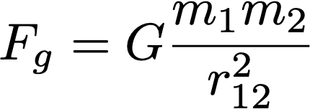
Gravity - The Force
One component of gravity is a force between two objects with mass:

Slide 14
Gravity - The Force
One component of gravity is a force between two objects with mass:
Note: what is the dimensionality of this quantity?
What else does Fg equal?

Slide 15
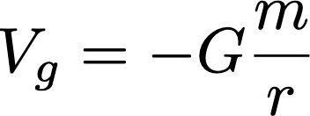
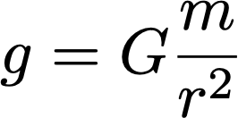
Gravity - The Force, The Potential, The Field
One component of gravity is a force between two objects with mass:
Gravity is also a potential:
And a field:

Slide 16
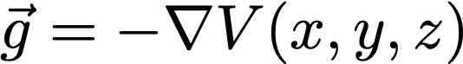
Gravity - The Force, The Potential, The Field
One component of gravity is a force between two objects with mass:
Gravity is also a potential:
And a field:
The field is the negative gradient of the potential:

Slide 17
Gravity - The Force
One component of gravity is a force between two objects with mass:
Gravity is also a potential:
And a field:
The field is the negative gradient of the potential:
This is the magnitude of the vector field

Slide 18
Gravity - The Force, The Potential, The Field
One component of gravity is a force between two objects with mass:
Gravity is also a potential:
And a field:
Note that this looks identical to the force Fg, but with only one mass, what is it?

Slide 19
Gravity - The Force, The Potential, The Field
One component of gravity is a force between two objects with mass:
Gravity is also a potential:
And a field:
What is this? Units are acceleration

Slide 20
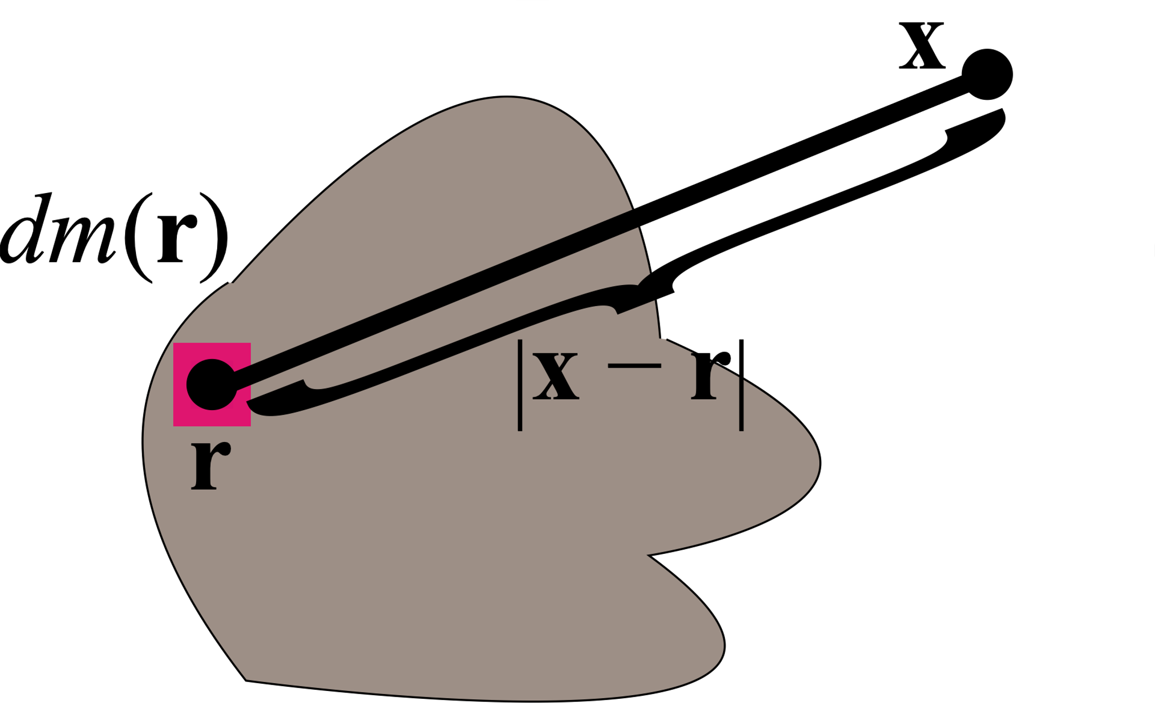
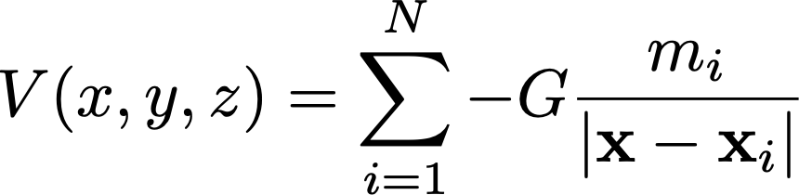
Gravity - The Field
We can measure the the vertical component of the local acceleration of gravity, g
We relate these variations to spatial variations in m
We can integrate or sum to obtain the full potential:
Sławomir Biały, Incnis Mrsi, Wikipedia Commons

Slide 21
Gravity - The Field
We can measure the the vertical component of the local acceleration of gravity, g
We relate these variations to spatial variations in m
We can integrate or sum to obtain the full potential:
Note that acceleration is always a vector, but we usually take only the vertical component of the vector, which is perpendicular to the potential and parallel to a plumb line
Sławomir Biały, Incnis Mrsi, Wikipedia Commons

Slide 22
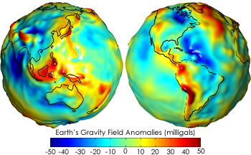
The Geoid
The geoid is an equipotential surface; i.e. V = constant
The geoid is one particular equipotential surface, there are infinitely many others

Slide 23
The Geoid
What are the variables? I.e. what causes these variations?

Slide 24
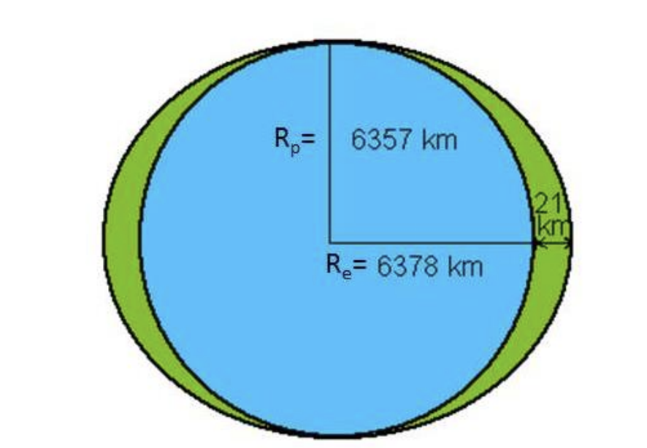
The Geoid
What are the variables?
Earth’s flattening due to rotation
Gravity is stronger at the poles due to being closer to the center of mass of the earth
Q. What about the extra mass at the equator?
http://appliedgeophysics.berkeley.edu/gravity/

Slide 25
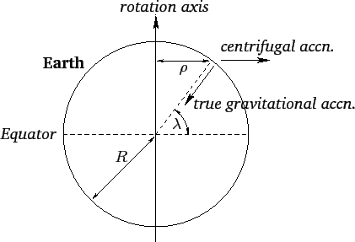
The Geoid
What are the variables?
Earth’s flattening due to rotation
Centrifugal acceleration due to rotation (acts opposite g)
The centrifugal acceleration cancels out a portion of g
Q. What is the functional form of a_{c}?
https://farside.ph.utexas.edu/teaching/336k/Newtonhtml/node57.html

Slide 26
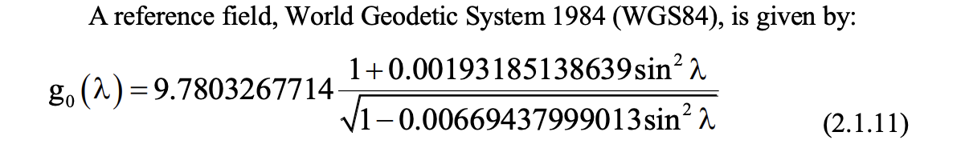
The Geoid
What are the variables?
Earth’s flattening due to rotation
Centrifugal acceleration due to rotation (acts opposite g)
These result in a latitude dependence, i.e. ellipsoidal geoid
http://appliedgeophysics.berkeley.edu/gravity/

Slide 27
The Geoid
What are the variables?
Earth’s flattening due to rotation
Centrifugal acceleration due to rotation (acts opposite g)
These result in a latitude dependence, i.e. ellipsoidal geoid
http://appliedgeophysics.berkeley.edu/gravity/
Many different formulas given online, some of them are incorrect. All are at best approximations of the true geoid, because of the ellipsoidal approximation

Slide 28
The Geoid
The geoid is an equipotential surface; i.e. V = constant
The local vertical direction (i.e. local gravity acceleration direction) varies as the potential varies

Slide 29
The Geoid
The geoid is an equipotential surface; i.e. V = constant
The local vertical direction (i.e. local gravity acceleration direction) varies as the potential varies away from the ellipsoid
This is known as “deflection of the vertical”

Slide 30
The Geoid
The geoid is an equipotential surface; i.e. V = constant
The local vertical direction (i.e. local gravity acceleration direction) varies as the potential varies away from the ellipsoid
This is known as “deflection of the vertical”
Q. What is causing these variations?

Slide 31
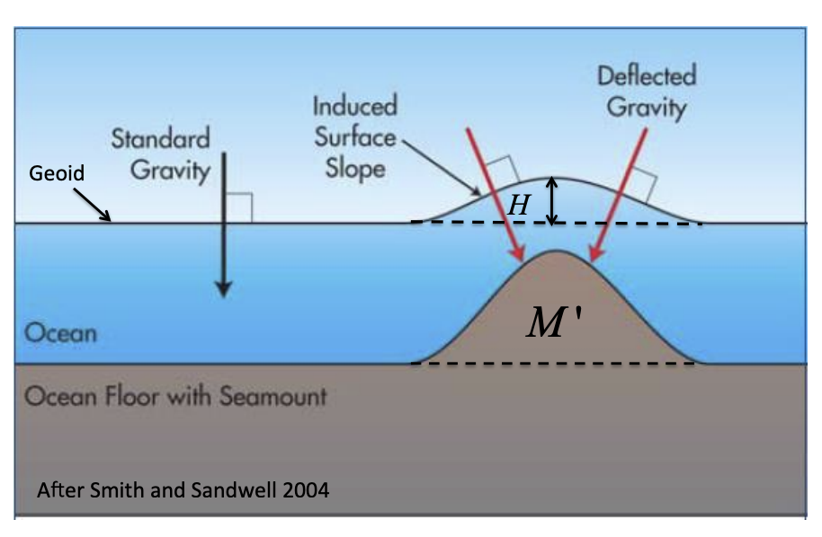
The Geoid
The geoid is an equipotential surface; i.e. V = constant
The local vertical direction (i.e. local gravity acceleration direction) varies as the potential varies away from the ellipsoid
This is known as “deflection of the vertical”
http://appliedgeophysics.berkeley.edu/gravity/
Example: Undersea volcano

Slide 32
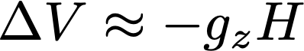
How to measure the geoid?
Satellite tracking + ground measurements + integration
Iterative process to refine the geoid then re-estimate

Slide 33
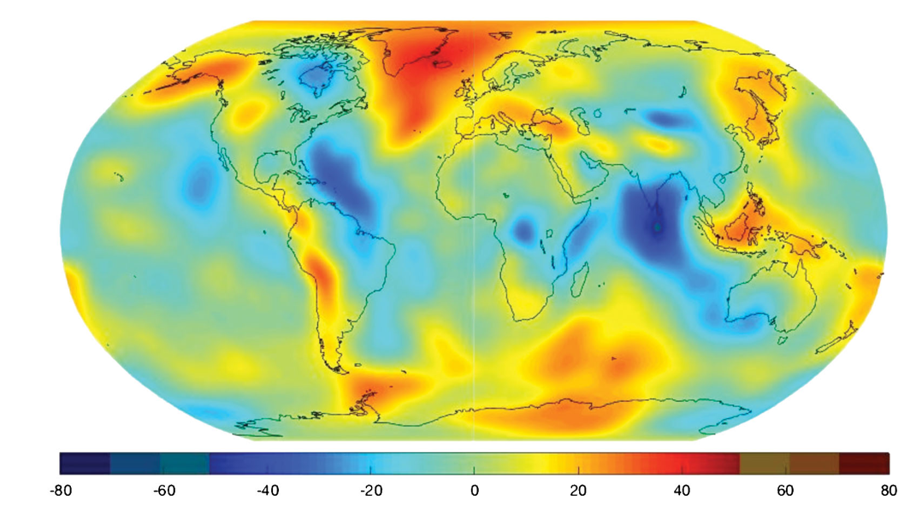
How to measure the geoid?
Satellite tracking + ground measurements + integration
Iterative process to refine the geoid then re-estimate

Slide 34
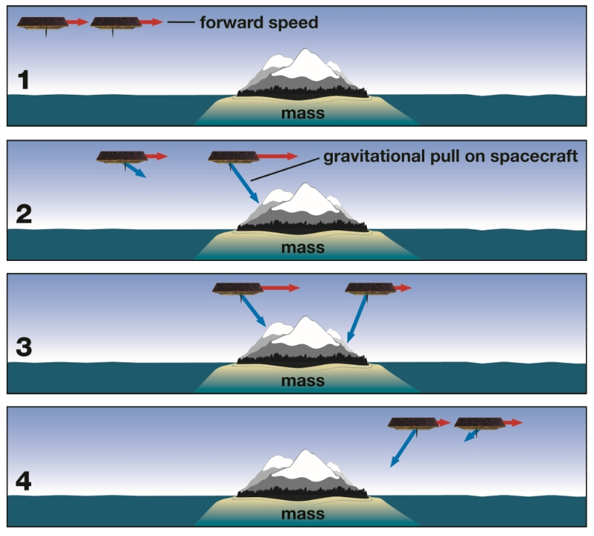
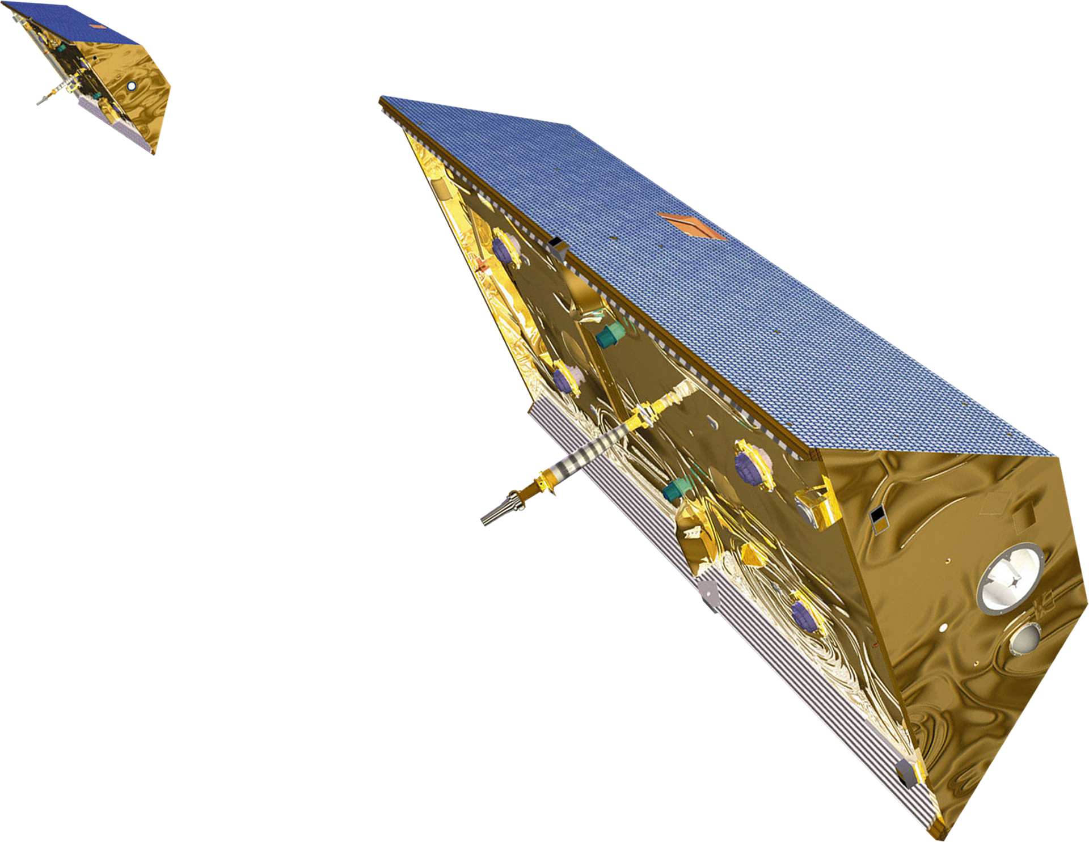
GRACE and GRACE Follow-on
Satellite tracking

Slide 35
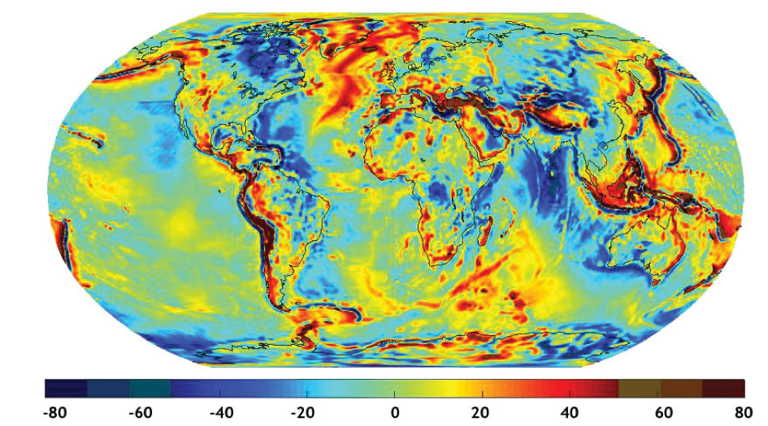
GRACE and GRACE Follow-on
Satellite tracking

Slide 36
Types of Coordinate systems: WGS-84
A global framework / coordinate system / datum / standard
Encompasses an Earth gravity model (EGM), World magnetic model (WMM), and a coordinate reference system (CRS)
EPSG: 4326 (2D), EPSG: 4979 (3D lat/lon), EPSG: 4978 (geocentric XYZ)
Ellipsoidal shape approximation for the earth

Slide 37
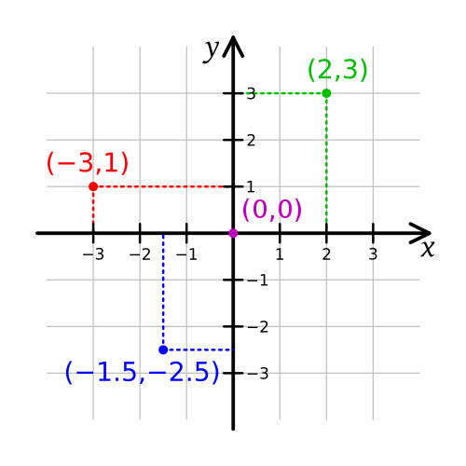
UTM and local coordinate systems
Require an origin point near the survey location
For a local survey, the origin point is denoted (0,0)
The origin need have no other significance, as long as we can measure locations relative to it
A local origin can only be used when it is not necessary to tie multiple surveys

Slide 38
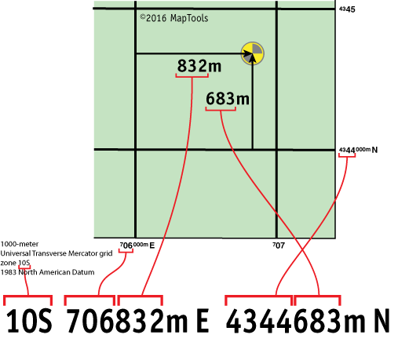
UTM and local coordinate systems
Require an origin point near the survey location
For a local survey, the origin point is denoted (0,0)
UTM works by establishing a global grid of local “benchmarks” or origin points
Local origin
https://www.maptools.com/tutorials/utm/quick_guide

Slide 39
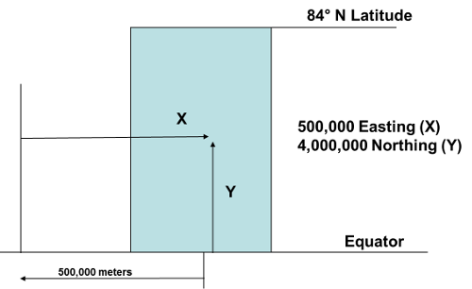
UTM and local coordinate systems
Require an origin point near the survey location
For a local survey, the origin point is denoted (0,0)
UTM works by establishing a global grid of local “benchmarks” or origin points
Several types of UTM coordinate systems exist
Origin is 500,000 m west of the central meridian

Slide 40
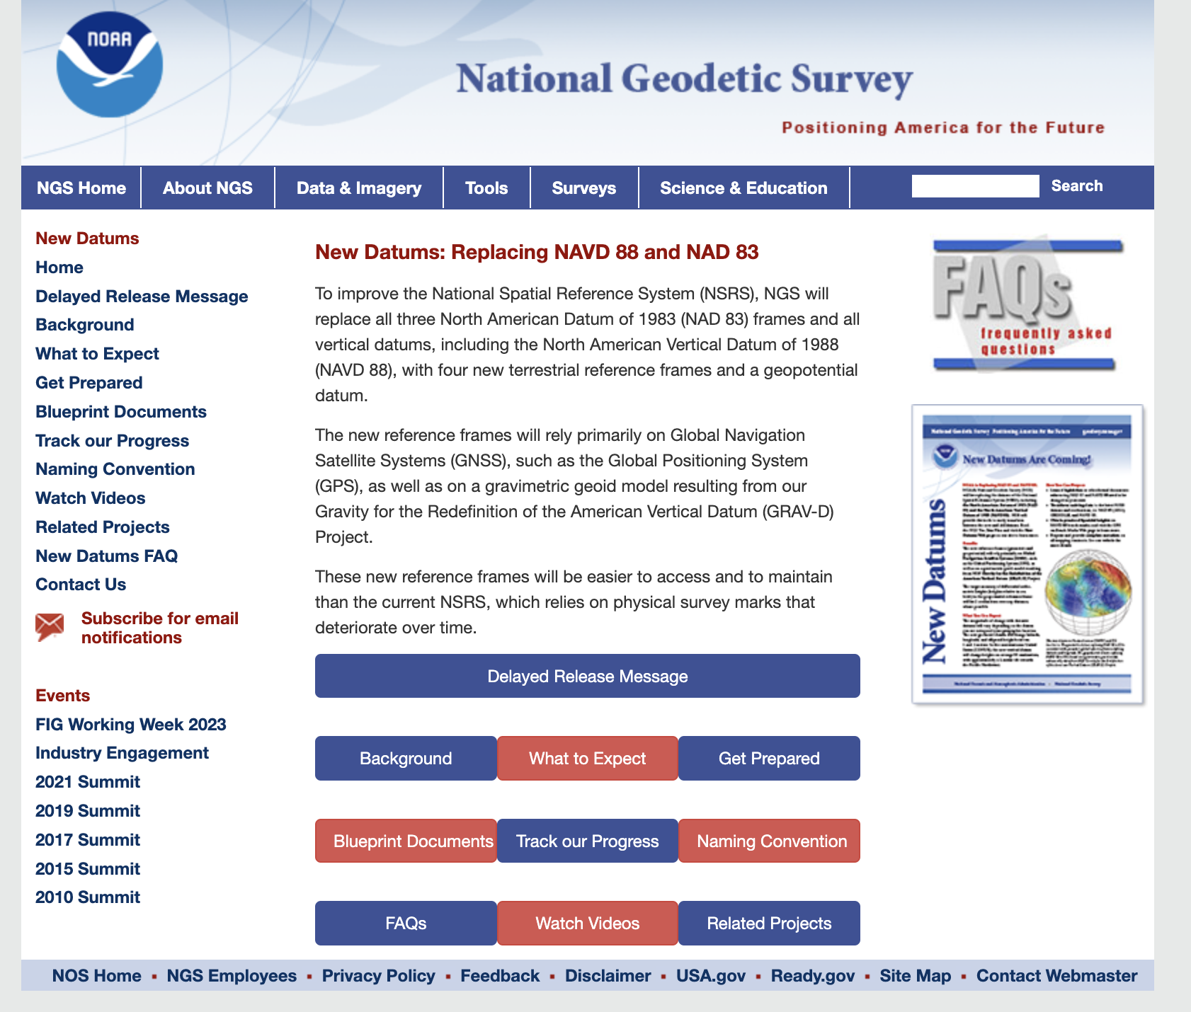
New geodetic datums will include plate motions
https://geodesy.noaa.gov/datums/newdatums/index.shtml

Slide 41
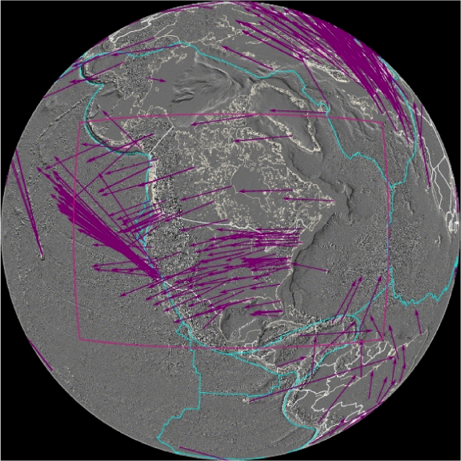
Reference Frames for motions and tectonics
Plate tectonic motions are defined RELATIVE to a given reference frame
Velocities compared to International Terrestrial Reference Frame 2008 (IGS08 is GPS reference frame name)
Hot spot constellation as “stable”
Notes:
Compared to plate motions, hot spots are much more fixed, so a global reference frame has been defined in comparison to that hot spot constellation.
Image from UNAVCO

Slide 42
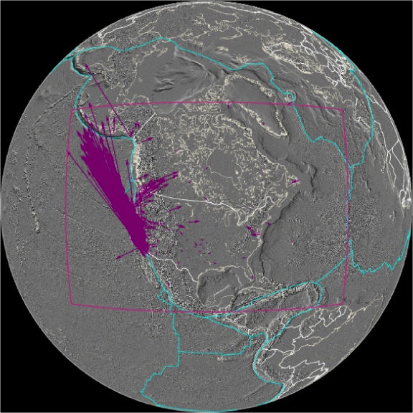
Reference Frames for motions and tectonics
Plate tectonic motions are defined RELATIVE to a given reference frame
Velocities compared to stable North America (called NAM08 reference frame)
Eastern North America as “stable”
Notes:
More useful for most typically applications is to consider a local reference frame where movement in a deforming plate boundary is compared to the more stable, less-deforming region.
Image from UNAVCO
For more on reference frames see:
https://www.unavco.org/software/visualization/GPS-Velocity-Viewer/GPS-Velocity-Viewer-frames.html

Slide 43
Conclusions
Geodetic coordinates systems are critical for mapping, topography, surveying, etc
Require defining an origin point, units of distance, coordinates in 3D
Coordinate systems on Earth often use lat/lon/height, but other local or regional systems are also used
You must always know or specify your coordinate system when working with geospatial or geodetic data

